Slide 1
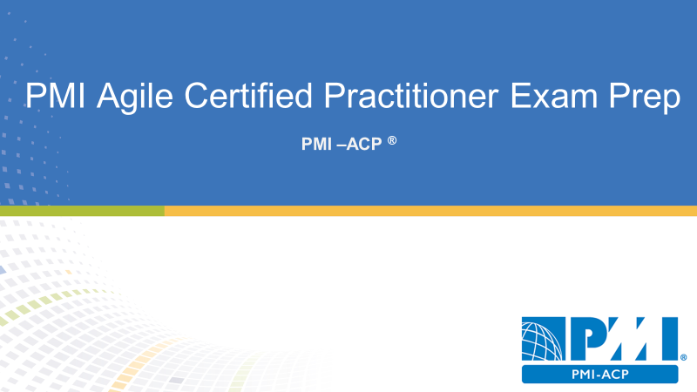
Domain III Stakeholder Engagement
17 % of PMI-ACP Exam
20 Questions

Slide 2
Stakeholder Engagement
Managing & Engaging the Stakeholders

Slide 3

Agenda
Working with the project stakeholders
Establishing a shared vision
Creating collaboration
Communicating with project stakeholders
Using interpersonal skills

Slide 4
Working with Project Stakeholder
Stakeholder Engagement

Slide 5
Stakeholder Engagement Tasks
Engage and empower business stakeholders
Share information frequently with all stakeholders
Form working agreements for participation
Assess organizational changes to maintain a stakeholder engagement
Used collaborative decision-making and conflict resolution
Establish a shared vision for project stakeholders
Maintain a shared understanding of project success
Provide transparency for better decisions
Balance certainty and adaptability for better planning

Slide 6
Who are Project Stakeholders?
Are impacted by the project
Can impact the project
Customers
Project sponsor
Project leaders
Development team
Vendors
End users

Slide 7
Identify Stakeholders
Stakeholder analysis
Expert judgment
Meetings
Create the stakeholder register

Slide 8
Plan Stakeholder Management
Expert judgment
Meetings
Analytical techniques
Create the stakeholder management plan
Update project documents

Slide 9
Manage Stakeholder Engagement
Communication methods
Interpersonal skills
Management skills
Issue log
Change request
Project management plan updates
Project document updates
Organizational process assets updates

Slide 10
Control Stakeholder Engagement
Information management systems
Expert judgment
Meetings
Work performance information
Change request
Project management plan updates
Project document updates
Organizational process assets updates

Slide 11
Keeping Stakeholder engaged
Agile project worked with stakeholders
Not command and control
Consider servant leadership
Identify project stakeholders as early as possible

Slide 12
Educating Stakeholders for Agile Projects
People new to agile projects need some basic education
Address concerns directly with project stakeholders
Explain the approach that will be used

Slide 13
Managing Stakeholder Engagement
Short iterations keep stakeholders involved
Reviews and demos show the results of the work
Agile places value of work that is done
Agile is naturally visible for project stakeholders

Slide 14
Incorporating Stakeholder Values
Work is based on what the stakeholders value
Engage the product owner to prioritize the backlog
Work is executed by priorities
The development team creates the highest priority items
The development team delivers early value to the business
Stakeholders are invited to planning meetings and retrospective

Slide 15
Incorporating Community Values
Agile teams must share the values of their broader community
Respect
Agile works for consensus
Don’t judge suggestions
Respect differing opinions
Courage
Agile teams display courage through demonstrations
Pair programming
Product owner prioritizing requirements
Retrospective

Slide 16
Principles of Stakeholder Engagement
Get the right stakeholders
Insure a stakeholder participation
Manage stakeholder interest
Frequently discussed what done looks like
Show progress to project stakeholders
Openly discuss project estimates and projections

Slide 17
Creating a Shared Vision
Understanding what is requested and delivering what was requested

Slide 18
Failing Fast
Failing fast means failing early and cheaply
Good way to discover misunderstandings
Ensures the project team understands what stakeholders want

Slide 19
Creating an Agile Charter
Agile charters authorize the project and the project manager
Agile charters are from the project sponsor
Could be lightweight or very detailed
Acknowledge change is likely in the actual project

Slide 20
Agile Project Charters are different
Traditional charters are very specific
Agile charters are broad and high level
Agile charters define:
Who will be engaged
What is the project about
Where will the project take place
When will the project start and end
Why this project being chartered
How the goals of the project be achieved

Slide 21
Creating a Project Tweet
Project customers in the project team can work together to create a project tweet
Describe the goal of the project in 140 characters or less
This exercise defines a high-level description of the project
Elevator statement

Slide 22
What does “Done” Mean
Defining done is important for everyone
An example of a shared vision
User stories –done will mean developed documented and tested
Releases –done means there are no large defects or remaining change requests
Final project deliverables –priority features are implemented three months of trouble-free operation and satisfactory scores

Slide 23
Working with Agile Modeling
Modeling techniques for agile projects
The value is in discussion and creation of the model
Often treated on whiteboards and photographs for a record
Lightweight and barely sufficient

Slide 24
Use Case Diagram
How will the user use the solution

Slide 25
Sample Data Model

Slide 26
Screen Designs
What does the user interface look like

Slide 27
Wireframes
A quick mock-up of a product
Could be screens and data flows between screens
Ensures that everyone has the same understanding of the product
A form of low fidelity prototyping
Quick way to get feedback

Slide 28
User Personas
Biographical sketches of key stakeholders
Description of product users
Somewhat grounded in reality
Goal oriented
Show tangible and actionable outcomes
Focus on the users and who the users will be

Slide 29
Communication
Managing Communications in Agile Project

Slide 30
Plan Communication Management
Communication requirements analysis
Communication technology
Communication model
Communication methods
Meeting
Create the communications management plan
Update project documents

Slide 31
Manage Communications
Communication technology
Communication models
Communication methods
Information management systems
Performance reporting
Communicate with stakeholders
Update the project management plan project document organizational process assets

Slide 32
Control Communications
Information management systems
Expert judgment
Meetings
Work performance information
Change request
Update the project management plan project documents and organizational process a set

Slide 33
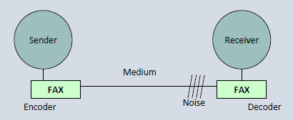
Communication Model – Sender - Receiver
Sender
Encoder
Medium
Decoder
Receiver
Barrier
Noise

Slide 34
Face to Face Communication
Face-to-face communication is preferred
Highest bandwidth of all communication types

Slide 35
Effectiveness of Different Communication Channels

Slide 36
Two-Way Communication
Dispatching model –top down communication
Collaborative model –interactive communication between sender and receiver

Slide 37
Knowledge Sharing
Knowledge sharing is critical for agile projects
Share information with everyone
Collective code ownership means any developer can edit any code at any time
Agile practices promote knowledge sharing:
Kanban boards
Information radiators
Personas
Wireframes

Slide 38
Communicating and Agile Projects
Low-tech high-touch tools
Stand up meetings
Osmotic communications
Tacit knowledge

Slide 39
What is an Information Radiator?
Highly visible displays of information
Large graphs or charts that summarize project data
Out in the open and easily accessible
Also known as visual controls

Slide 40
What is an Information Radiator?
Features delivered versus features remaining
Who is working on what
Current iteration features to be created
Velocity and defect measurements
Retrospective outcomes
Threats and issues for the project
Burn up and burndown chart
Story maps

Slide 41
Social Media and Agile Projects
Remote workers staying in touch
Facebook
Twitter
Web collaboration tools
Non co-located teams
Consider the sensitivity of the project information

Slide 42
Collaboration
Collaborative Approach is the key in Agile Project

Slide 43
Collaboration is the key in agile projects
Customer collaboration over contract negotiation
Business people and developers must work together daily throughout the project

Slide 44
Benefits of Collaboration
Generates wiser decisions
Promotes problem solving
Promotes action
Build social capital
Ownership of collective problems

Slide 45
Engaging People in Agile Projects
Engagement creates better ideas and put some conversations
Active problem solving instead of command and control
Taking action rather than being passive
Collective ownership of ideas
Motivates and engages the project team
Shifts the power downward

Slide 46
Green Zone Vs Red Zone
Green Zone | Red Zone
Takes responsibility Responds non-defensively Not easily threatened Build mutual success Seeks solutions Uses persuasion Firm, but not rigid Thinks both short-term and long-term Considers other points of views Welcomes feedback Considers conflict to be natural Speak calmly and directly about difficult issues Accept responsibility Seeks excellence | Blames others Responds defensively Feels threatened or wrong Triggers defensiveness Holds grudges Shame, blame, and accusations Binary thinking Short-term advantage Feel victimized Doesn’t seek feedback Must win at any cost Is rigid and reactive Creates a climate of antagonism Disapproval and content Sees others as the enemy Does not listen effectively

Slide 47
Hosting Workshops
Meetings for participants to get work done
Clear goals and a schedule
Retrospectives
Planning meetings
Estimating sessions

Slide 48
Tips for a great workshop
Have a diverse group of people
Facilitated for involvement
Get people involved early

Slide 49
User Story Workshops
Preferred approach for candidate user stories
Also known as story writing workshops
Optimize the workflow by understanding user needs
Engage stakeholders in the design process

Slide 50
Brainstorming
Collaborative technique too rapidly generate lots of ideas
Maximize number of suggestions
No stupid ideas
Will sort through the ideas later

Slide 51
Brainstorming Methods
Quiet writing
Round robin
Free for all

Slide 52
Collaboration Games
Also known as innovation games
Remember the future
Prune the product tree
Speed boat
Buy a feature
Bang for the buck

Slide 53
Remember the Future
Collaboration game
Stakeholders look back at the project
20 minutes to write a future report about how the project went
Includes what was created; written on sticky notes
Notes are moved into associated clusters and duplicates removed
This game define success

Slide 54
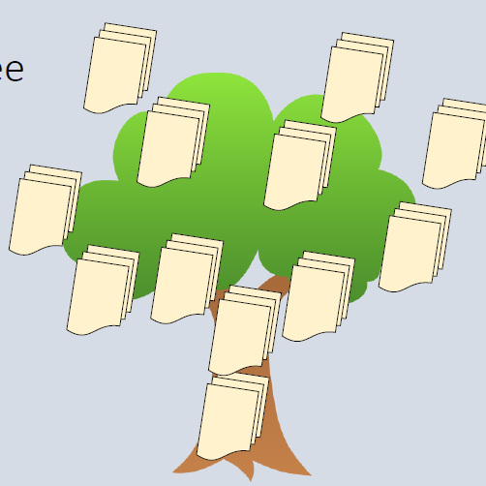
Prune the Product Tree
Drawing of a big tree
The trunk is what we already know or have built
The branches are new functionality and what needs to be designed
Participants add features on sticky notes to the tree
Closer to the trunk represents higher priority

Slide 55

Speed Boat Games - Sailboat
Imagine it’s a boat
What winds are pushing the sailboat
What anchors are holding the sailboat back
What direction is the sailboat going
What rocks are in the way

Slide 56
Interpersonal Skills for Agile Success
The Soft stuff is the hard stuff and the hard stuff is the easy stuff

Slide 57
Interpersonal skills for agile projects
Emotional intelligence
Active listening
Facilitation techniques
Negotiation
Conflict resolution
Participatory decision making

Slide 58
Emotional Intelligence
The ability to identify and influence our emotions and the emotions of others

Slide 59
Quadrants of Emotional Intelligence
Self-management
Self control
Conscientiousness
Adaptability
Drive and motivation
Self-awareness
Self confidence
Emotional self-awareness
Accurate self-assessment
Social skills
Influence
Inspirational leadership
Developing others
Teamwork and collaboration
Social awareness
Empathy
Organizational awareness
Understanding the environment

Slide 60
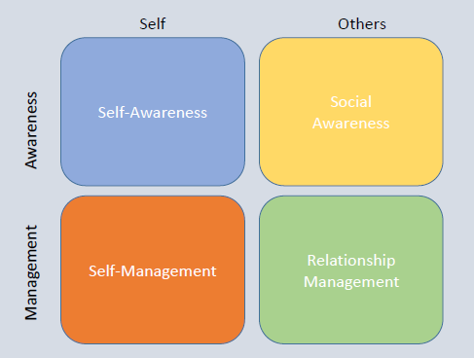
Quadrants of Emotional Intelligence

Slide 61
Active Listening
Hearing what someone is really trying to say
Level 1 –Internal listening
Level 2 –Focus listening
Level 3 –Global listening

Slide 62
Active Listening..
Level 1 – Internal Listening
Words are heard, but we’re not very attentive
We interpret the meaning –how is this going to affect me
Level 2 –Focus listening
The speaker’s perspective
We empathize with the speaker
We look for emotional indicators such as voice and tone
Facial expressions and words
Level 3 –Global listening
We build on level 2
A higher level of awareness
Subtle clues about meeting such as the speaker’s posture and energy
Helps us to develop a fuller context of the message

Slide 63
Facilitation
Running effective meetings and workshops
Goals –ensuring that meetings are not a waste of time by promoting participation
Rules –establishing ground rules and holding people accountable to these rules
Timing –the duration of the meeting is established ahead of time
Assisting –making the meeting effective and assuring that everyone may contribute

Slide 64
Negotiations
Negotiations happen throughout the project
Consider the priorities of user stories
Avoid a zero-sum games where only one person wins
Healthy negotiations allow for give and take

Slide 65
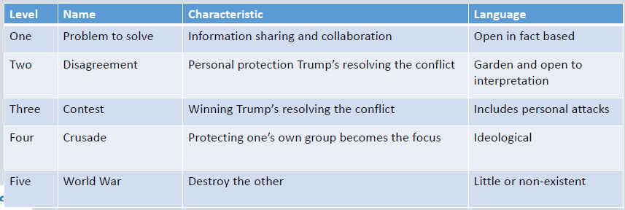
Conflict Resolution
Differences of opinions and competing interest
Some conflict is healthy

Slide 66
Participatory Decision Making
Engaging stakeholders for decision making
Communication and decision-making are critical to keep everyone informed then engaged
Involves stakeholders when making decisions
Stakeholder involvement increases as they commit to the project

Slide 67
Convergent and Shared Collaboration
Convergent –participating decision making models in for conversions for collective agreements
Shared collaboration they share the decision-making process fairly

Slide 68
Simple Voting
Participatory decision approach
The team votes for or against an idea by a show of hands

Slide 69
Thumbs Up, Down or Sideways
Thumbs up and individual is for the decision
Thumbs down and individual is against the decision
Thumb sideways the individual is neutral or undecided

Slide 70
Fist of Five Voting
The number of fingers shown indicates degree of support

Slide 71
Highsmith Decision Spectrum
Participants place a checkmark on a spectrum
In favor
Okay but with reservations
Mixed feelings
Not in favor but will commit
Veto

Slide 72

Domain Completion
PMI-ACP
You have successfully completed –
Stakeholder Engagement domain

